Slide 1

Revolutionizing Electricity Billing and
Usage Tracking System
CSE 310
JAVA PROJECT
Presented to: Dr. A. Ranjith Kumar
Presented by: Master Ankur

Slide 2
CONTENTS
Introduction
Scope of the Project
Key Points
Modules
Conclusion

Slide 3
INTRODUCTION
This system is made to keep the records about the bills of the customers. The admin can manage all the accounts .
To develop an online system to electric bills for calculating and printing the bill. After filling the proper details like first it will open the login page.
Calculate the total amount of the bill using code written in java format. To collect the power consumption Unit Customer Id ,Customer Name , Address should be required.
Print button print the details which is given in the customers details and total amount of the bill.

Slide 4
SCOPE OF THE PROJECT
Some of the key components of an my project include:
First it splash for 7 sec and reloaded to login page. Here, we have to fill the credentials, and directly jump to main page.
The system can be used to add new customer and store the information about users.
The system can generate bills based on meter readings and can also print the bill.
It will generate the total amount based of the reading that I have mentioned in code. i.e. each unit rs.3.

Slide 5
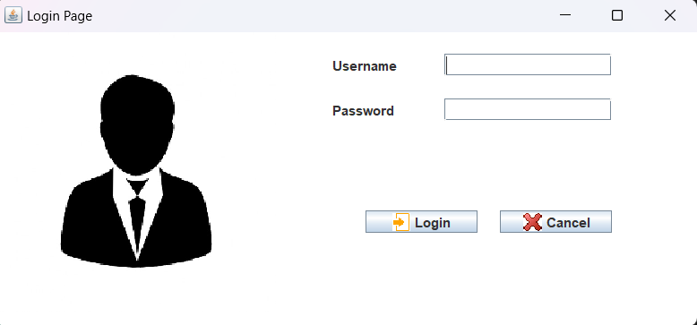
KEY POINTS
The class "Login" extends the JFrame class and implements the ActionListener interface. It contains two buttons: "login,“ and "cancel," and two text fields for the username and password, and an image.

Slide 6
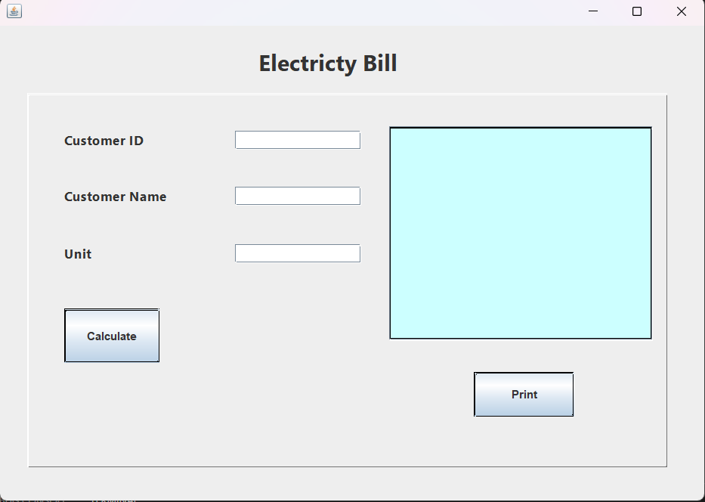
CONTD.
The ebill class extends the javax.swing.JFrame class, which means that it creates a new window where the components of the user interface will be displayed.
The jLabel1, jLabel2, jLabel3, and jLabel4 variables which are used to create labels for the customer ID, customer name, unit consumed, and the title of the application.
The jButton1ActionPerformed() method is called when the user clicks on the "Calculate" button. This method calculates the electricity bill based on the number of units consumed and displays it in the txtprint text area.

Slide 7
MODULES
Splash
Login
Ebill
Print

Slide 8
CONCLUSION
This is a simple billing system that is written in java language using basic GUI components. The main purpose of this ebill system is to calculate the bill according to the unit given in code after that it will generate the total amount and print the bill smoothly.
At last but not the least, its very amazing and many more I also learnt so many things and also improve my skills and it give the confidence to go to a new height.

Slide 9
THANK YOU

